Slide 1
Models of the motor system Sensory Systems
Spring 2025
Opher Donchin

Slide 2
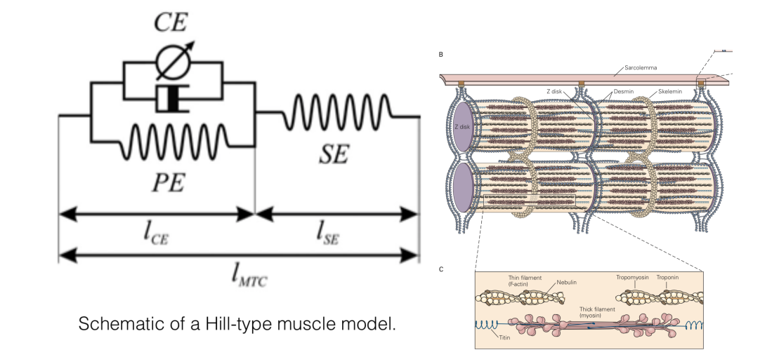
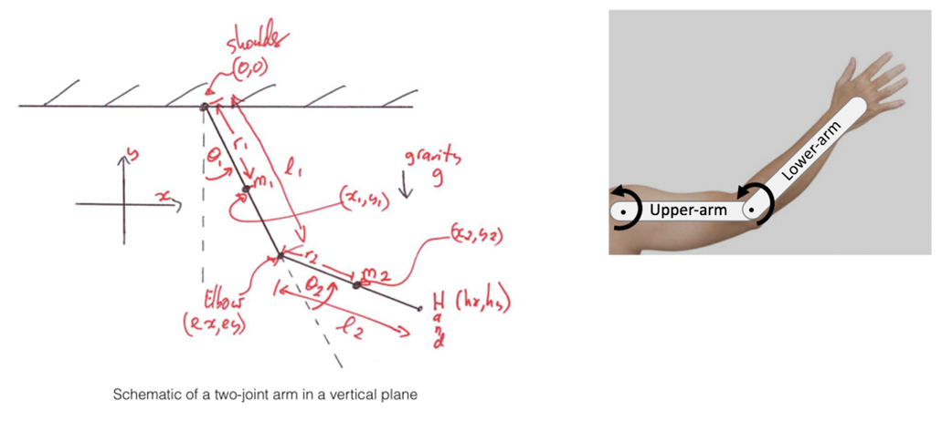
From Movement to Sensation
Last two weeks:
From muscles to actual movement
Hill-type models
Forward and inverse dynamic and kinematic models
Today:
For control we need sensation

Slide 3
Part 1
Why movement needs sensory feedback
Why can’t we rely on feedforward commands alone?
What happens if sensory signals are disrupted or missing?

Slide 4
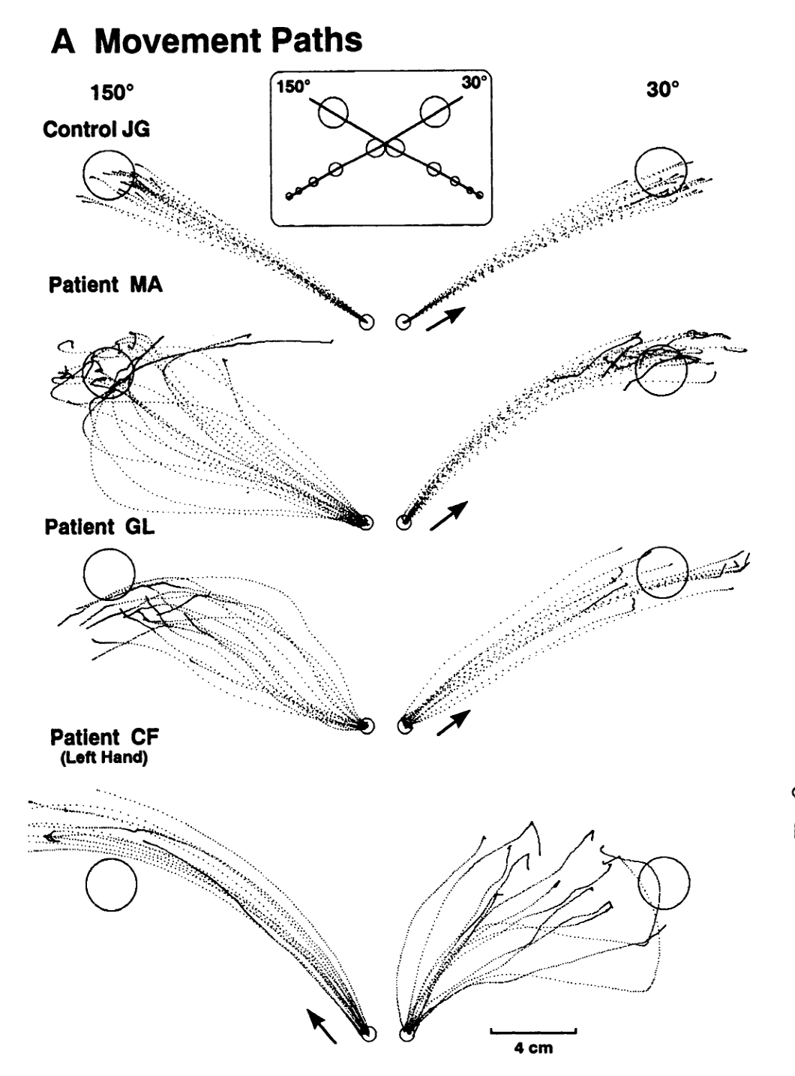
The essential role of sensation
Deafferentation
Sensory neuropathy
Loss of sensory fibers

Slide 5
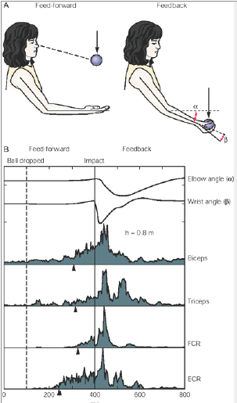
Feedforward vs Feedback
Feedback serves
Accuracy
Ongoing movements
Interjoint coordination

Slide 6
The many sensory systems

Slide 7
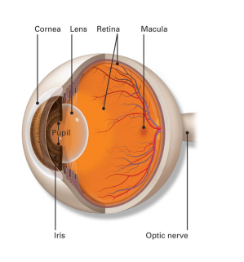
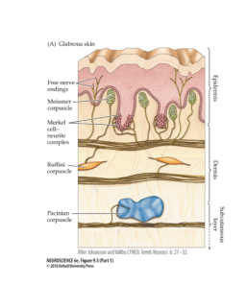
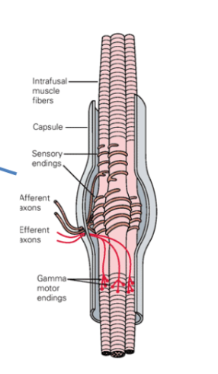
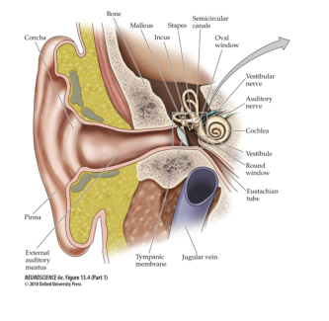
Senses that serve movement
Visual
What is going on far away
Vestibular
How am I moving through space
Touch
What am I next to?
Proprioception
Where is my body

Slide 8
Comparing the senses
Sense | What? | Precision? | Delay?
Visual | External objects | 0.3 mm at 1 m | 100-150 ms for online corrections
Vestibular | Head orientation and acceleration | 0.1 deg/s² angular acceleration | 10-15 ms
Touch | Skin contact and deformation | 1-2 mm two point discrimination | 20-24 ms
Proprioception | Muscle length and tension | 1-2º of joint angle | 20-250 ms

Slide 9
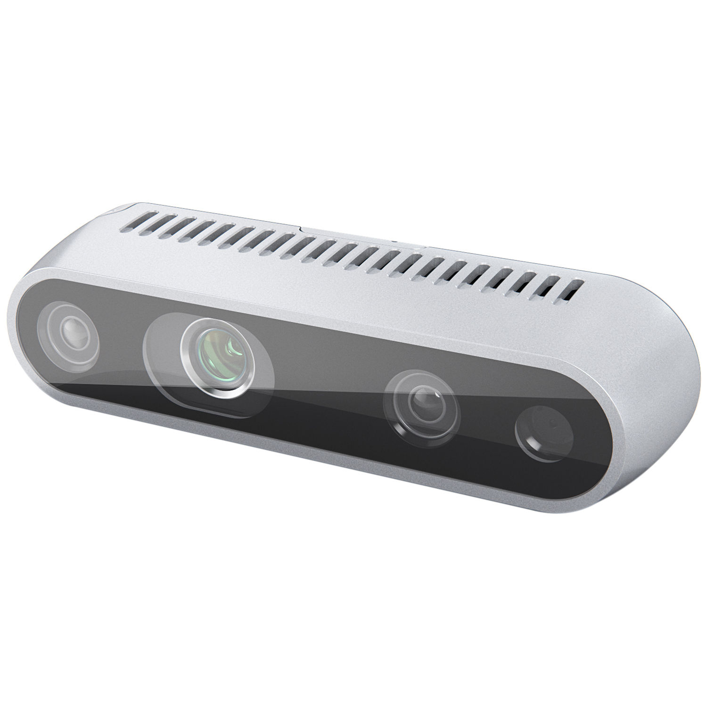
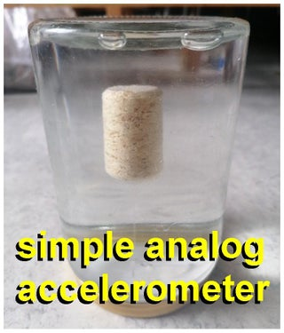
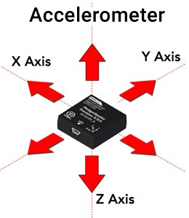
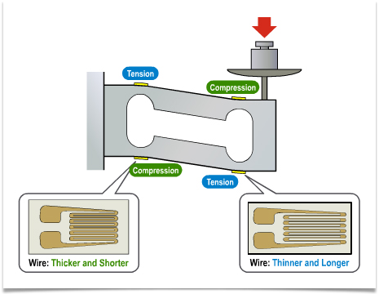
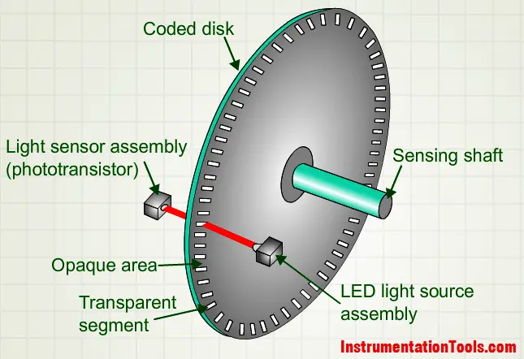
Technological Equivalents
Visual
Vestibular
Touch
Proprioception

Slide 10
Part 2
Vision: sensation at a distance despite delays
Slowest and most accurate sense

Slide 11
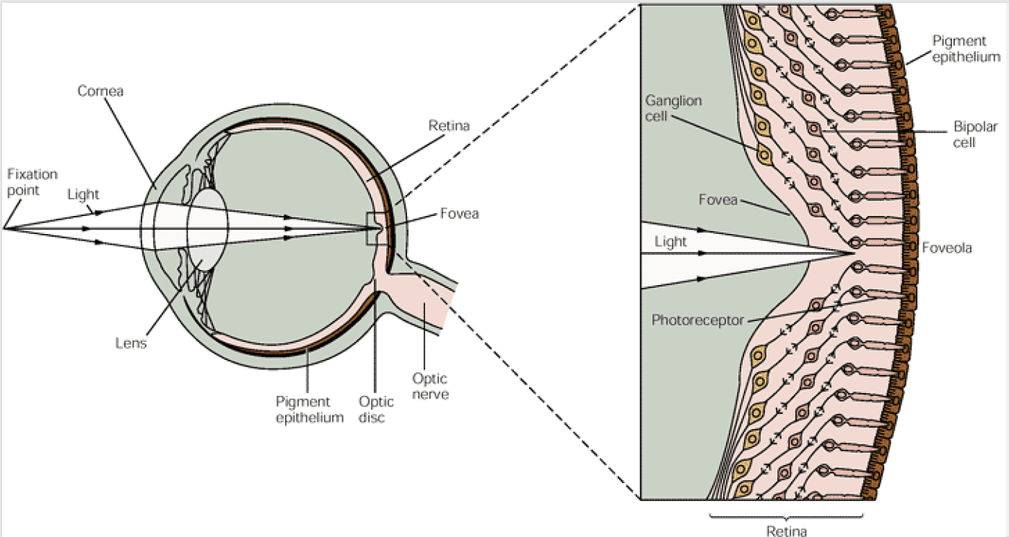
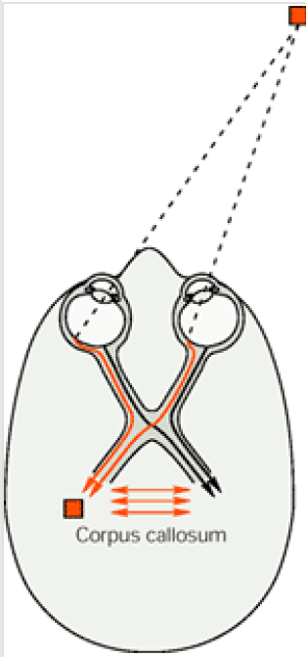
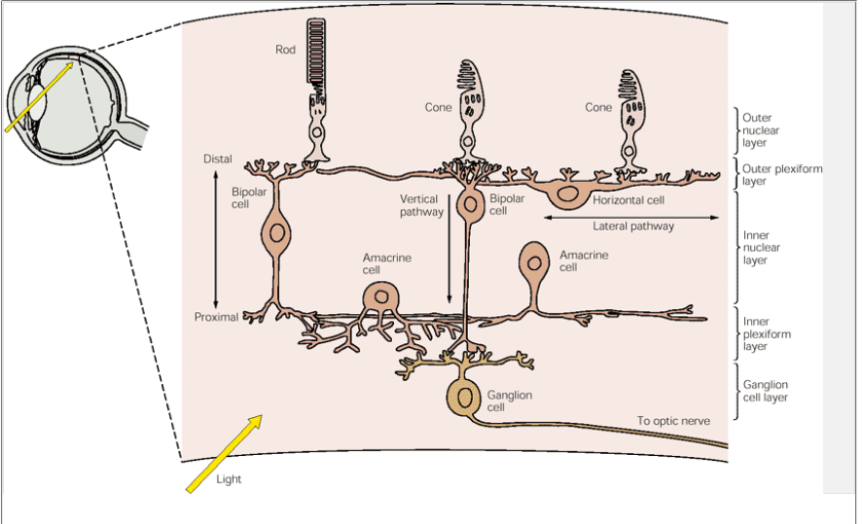
The eyes and the retina
Complex processing in the input stages

Slide 12
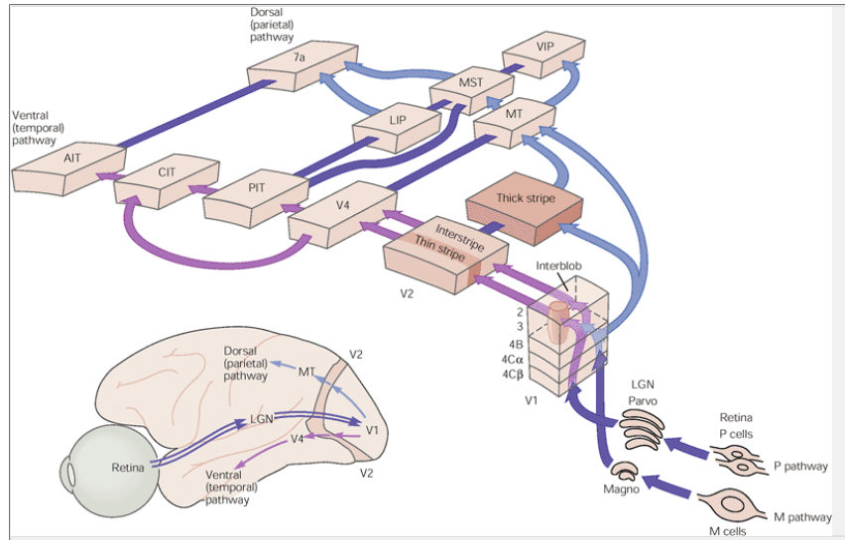
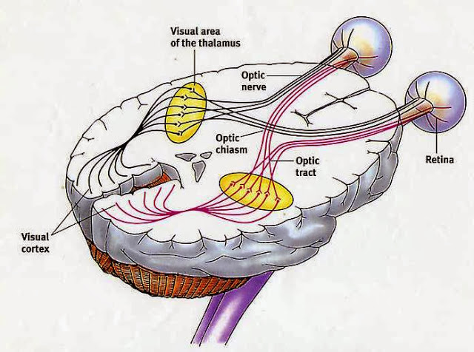
The visual pathway
To the cortex
In the cortex

Slide 13
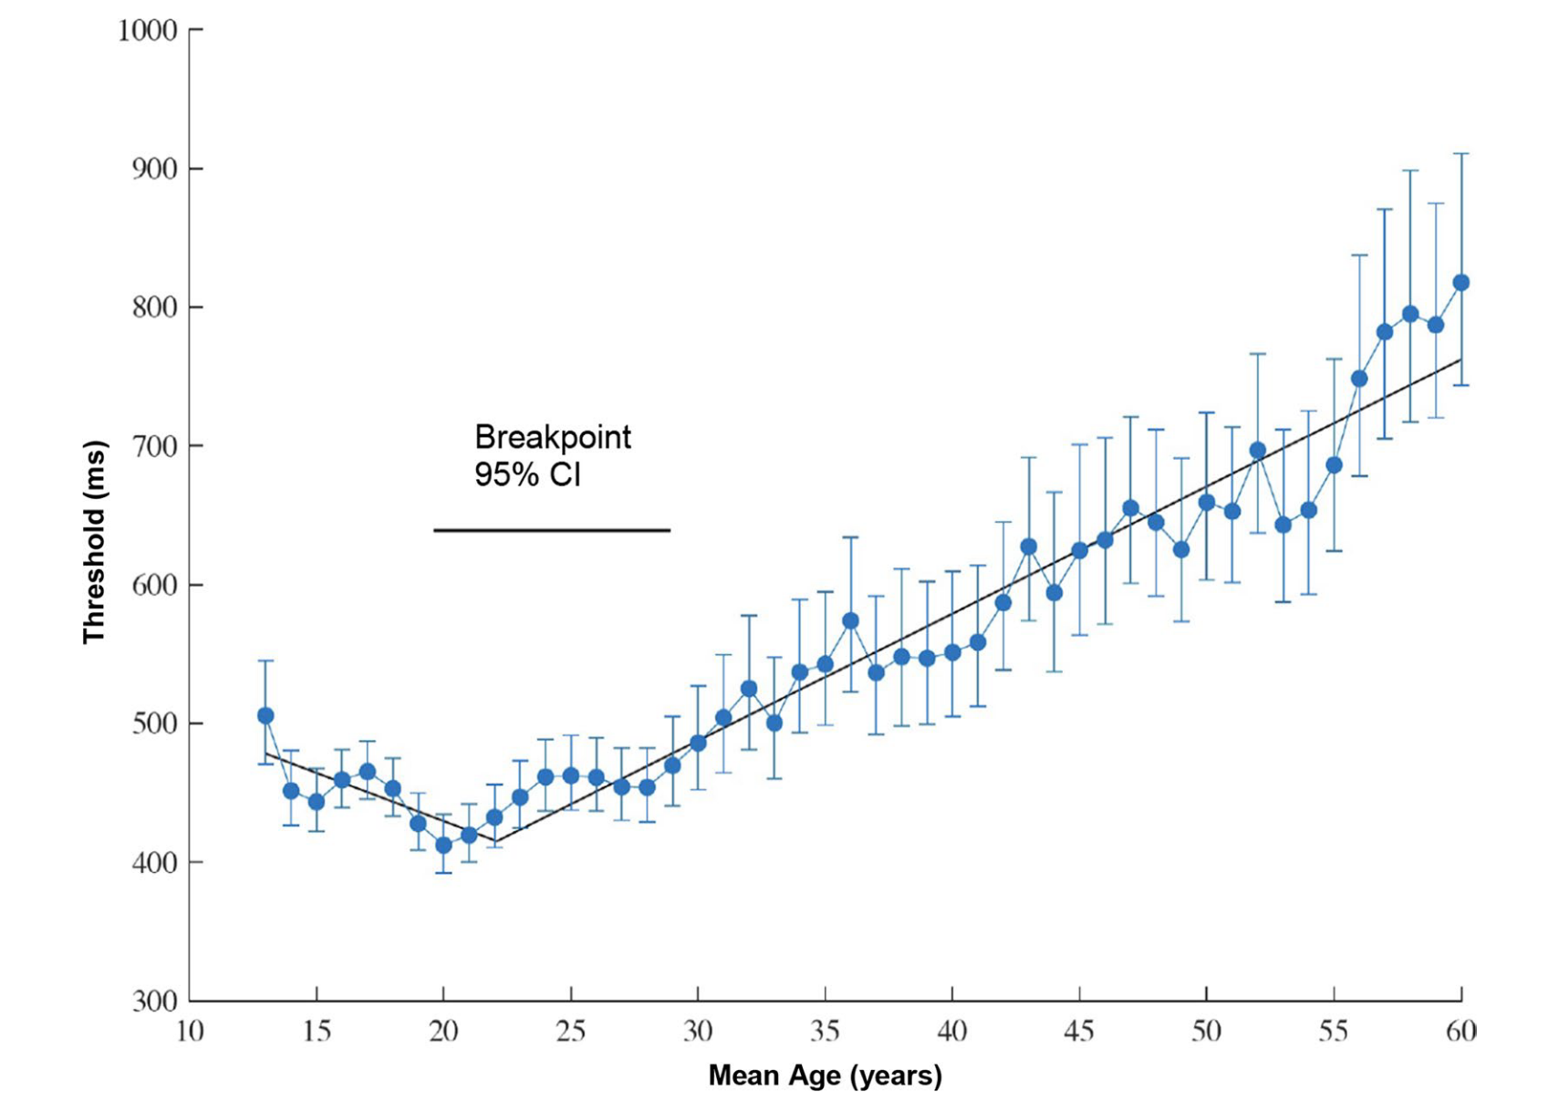
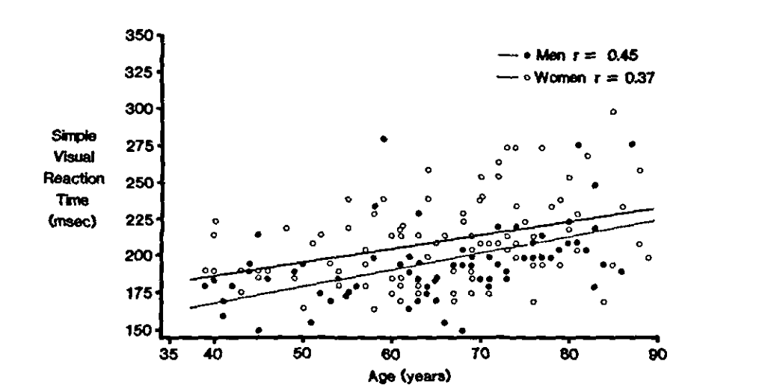
Visual processing speed
Simple reaction time: 200 ms
Complex visual search: 500 ms

Slide 14
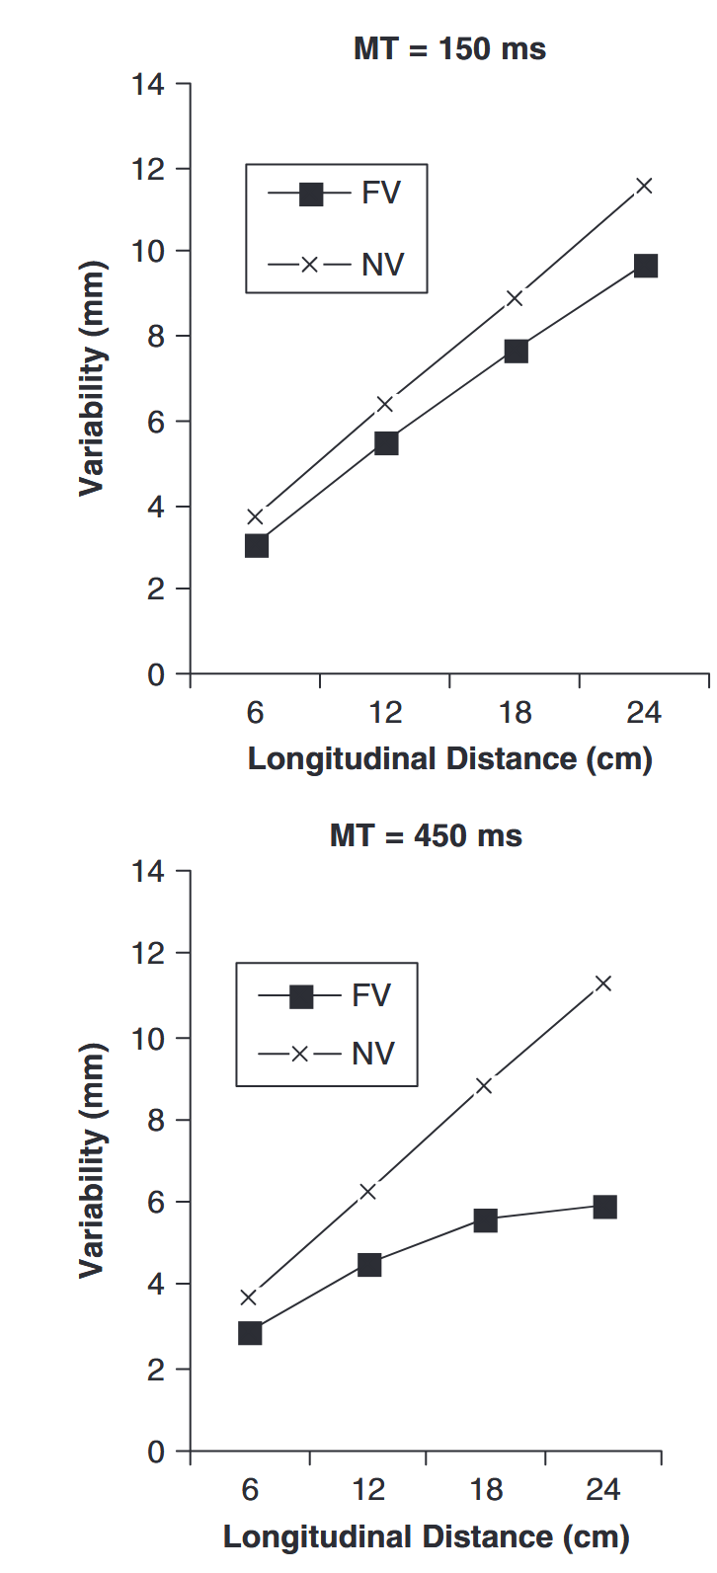
Vision in rapid accurate movements
Variability in fast movements increases
With movement distance
With and without vision
Variability in slow movements increases
Non-linearly in full vision
FV: Full vision
NV: No vision
MT: Movement time

Slide 15
Part 3
Vestibular: stabilizing orientation and balance
Vestibular reflexes create bodily stability

Slide 16
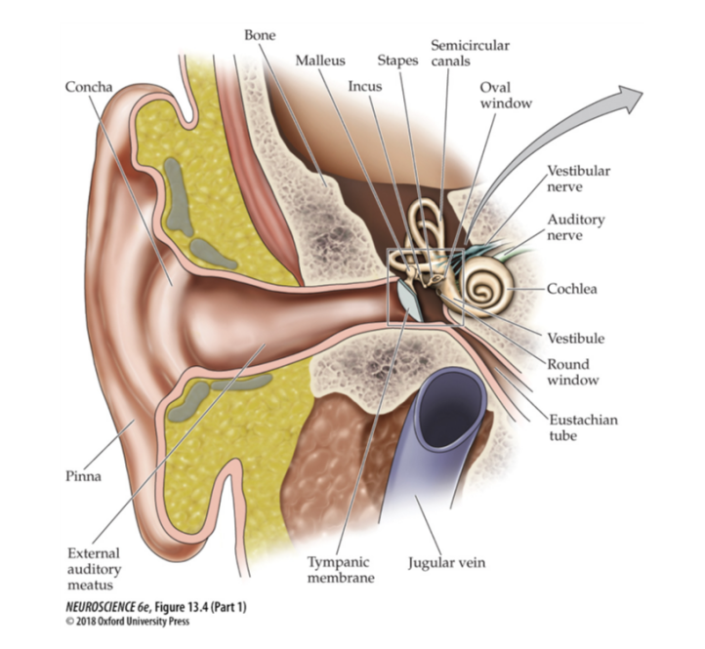
The vestibular receptors of the inner ear
Our vestibular organs are next to our auditory organs

Slide 17
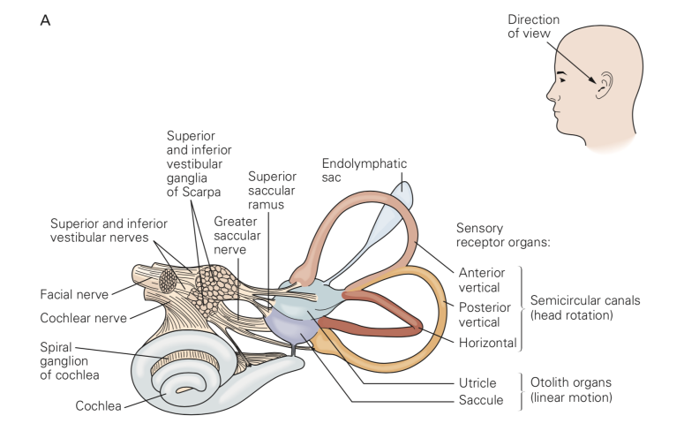
The vestibular receptors of the inner ear
Otolith organs for linear motion
Semicircular canals for rotational motion

Slide 18
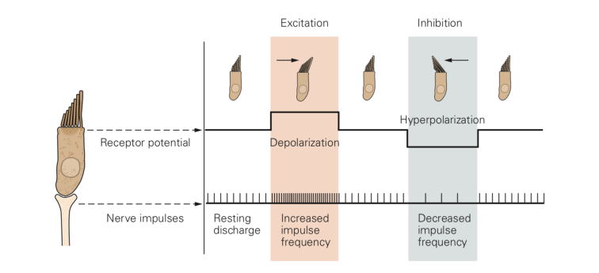
Hair cells inside the organs
Similar to the ones used in hearing
Acceleration causes flow in vestibular organs

Slide 19
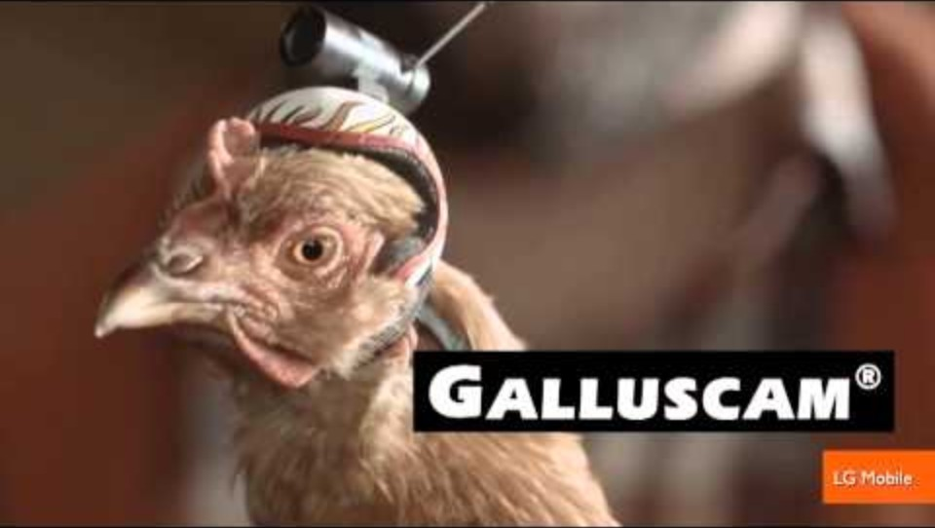
What does the vestibular system do?
Head stabilization using both visual and vestibular reflexes

Slide 20
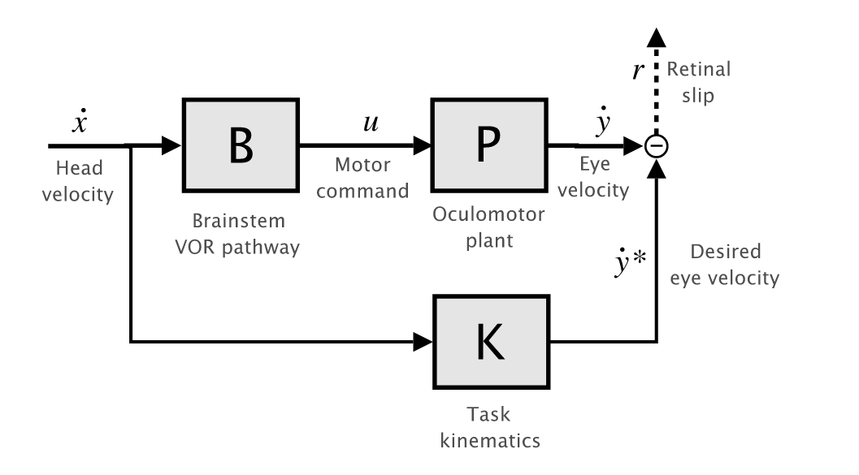
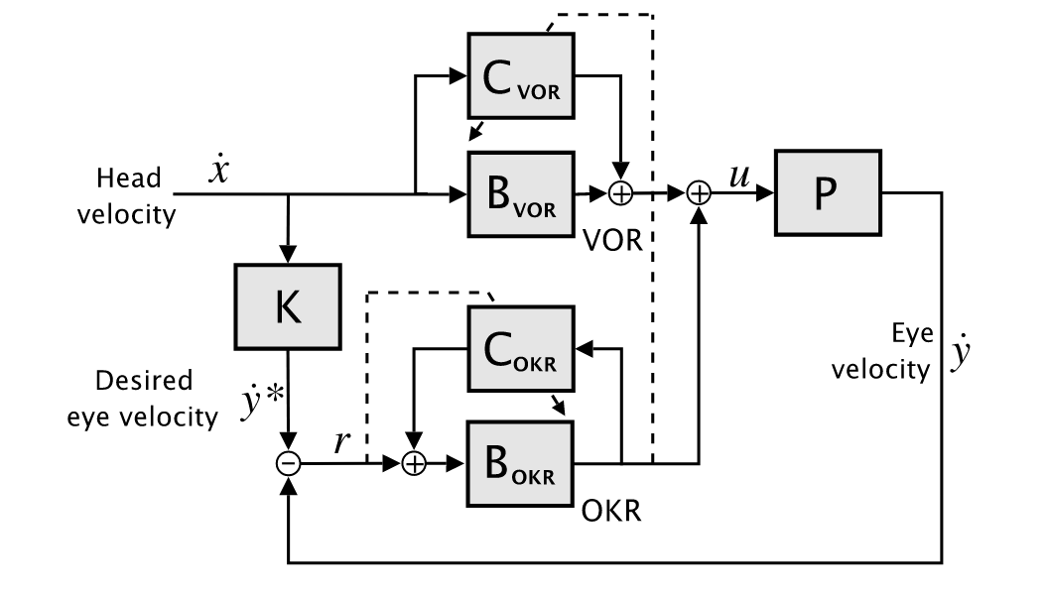
Models of the visual and vestibular reflexes
First model developed in 1981
Combined vestibulo-ocular reflex and optokinetic reflex
Vestibulo-Ocular Reflex

Slide 21
Part 4
Touch: the feeling of proximity
How do cutaneous receptors enable rapid ocrection
Why are some reflex pathways so fast?

Slide 22
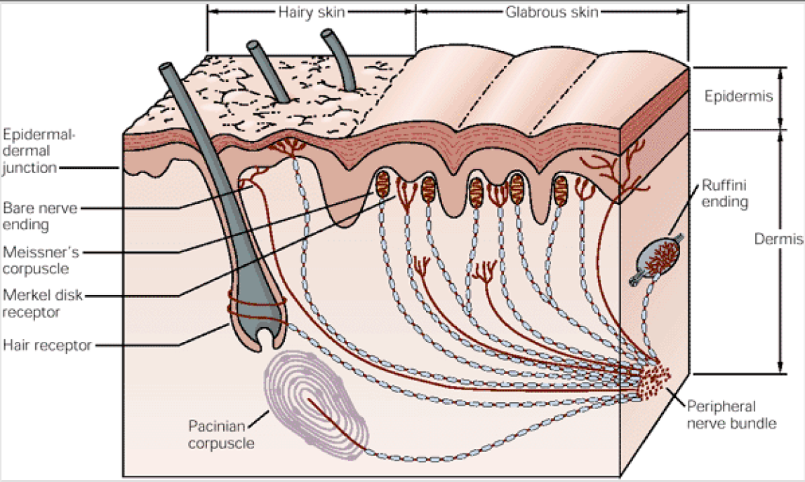
Receptors in the skin
Mechanoreceptors
Deformation: surface and deep
Chemoreceptors
Itching and foreign substances
Nociceptors
Tissue damage
Surface
Deep

Slide 23
Types of mechanoreceptors
 | Slow adapting | Rapid adapting
 | Ongoing touch | Change in pressure
Surface | Merkel disk | Meissner’s corpuscle
Deep | Ruffini ending | Pacinian corpuscle
Slow
adapting
Rapid
adapting

Slide 24
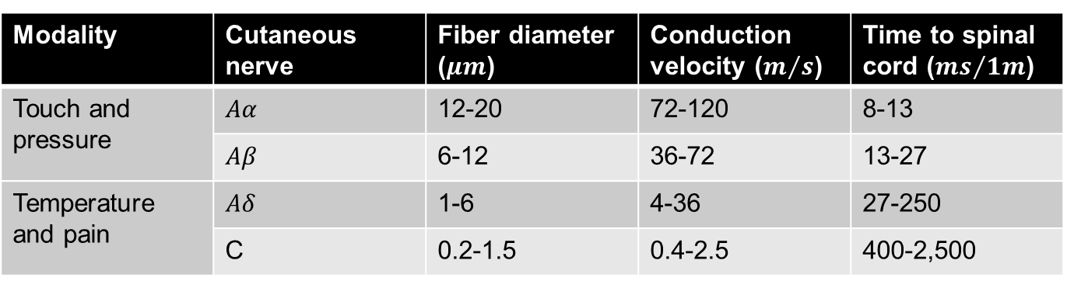
Conduction speeds
Touch and pressure are fastest signals
Reach spinal cord in 8-27 ms
Modality | Cutaneous nerve | Fiber diameter ($μm$) | Conduction velocity ($m/s$) | Time to spinal cord (${ms}/{1m}$)
Touch and pressure | $$Aα$$ | 12-20 | 72-120 | 8-13
 | $$Aβ$$ | 6-12 | 36-72 | 13-27
Temperature and pain | $$Aδ$$ | 1-6 | 4-36 | 27-250
 | C | 0.2-1.5 | 0.4-2.5 | 400-2,500

Slide 25
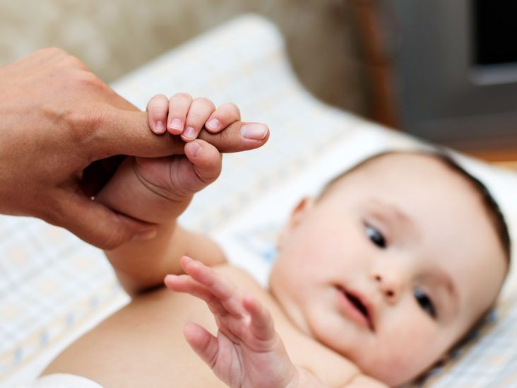
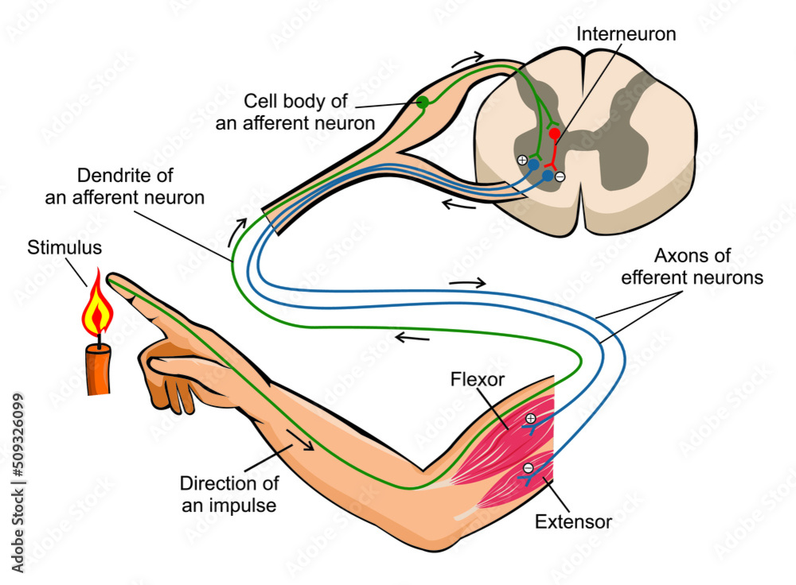
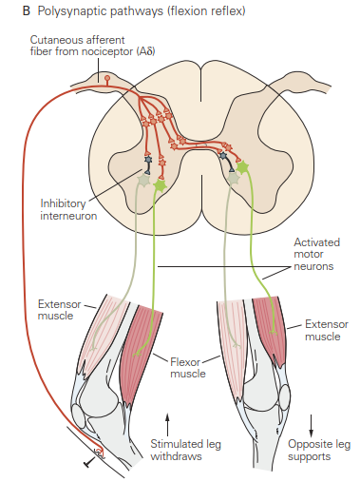
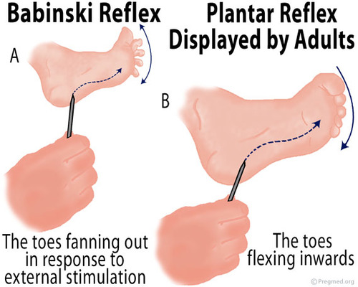
Cutaneous reflexes

Slide 26
Part 5
Proprioception: the feeling of my body
Where is my body?
What is it doing?

Slide 27
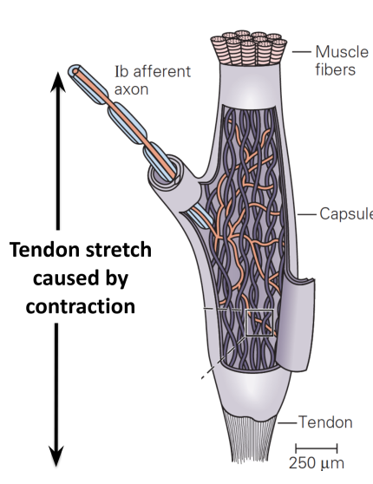
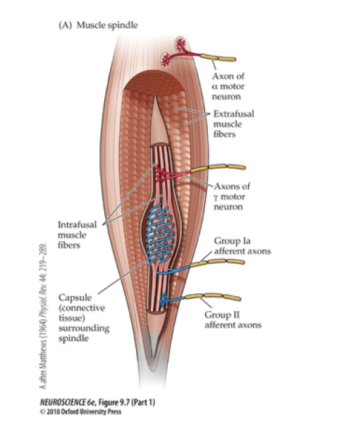
Muscle afferents
We know where our body is from sensors in the muscles and tendons
Muscle spindles
Golgi Tendon Organs
Length and velocity
Tension and force

Slide 28
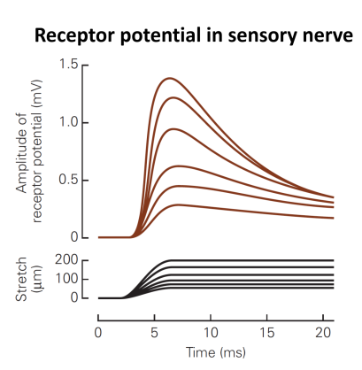
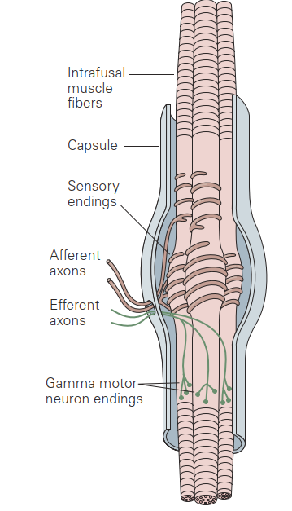
Muscle spindles
Convey muscle length and change
Multiplexed
Muscle spindles

Slide 29
Gamma motor neurons
Gamma motor neurons innervate intrafusal muscle fibers
They stretch muscle spindles
This affects spindle activity

Slide 30
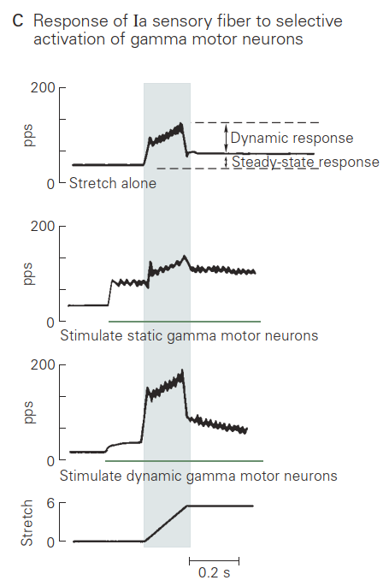
Gamma motor neurons influence spindle response
Gamma motor neurons innervate intrafusal muscle fibers
They stretch muscle spindles
This affects spindle activity
Muscle spindles signal unexpected change in length
Because gamma tension changes to match muscle tension

Slide 31
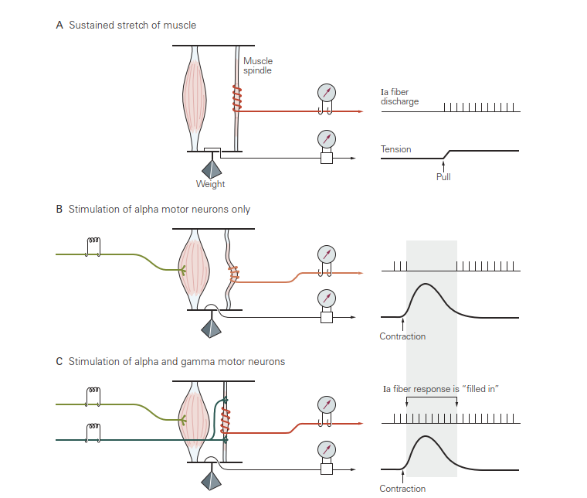
Spindles show gap between activation and stretch

Slide 32
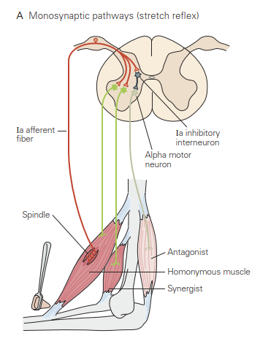
The stretch reflex
A muscle spindle reflex

Slide 33
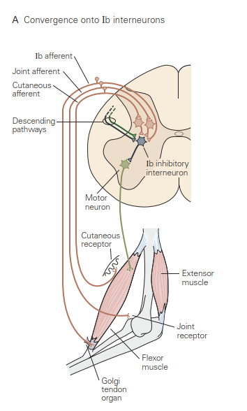
The integrated reflex
Multiple pathways contribute information

Slide 34
Part 6
Putting it all together:
Visual: slow and accurate
Vestibular: The body in space
Somatosensory:
Touch: The body in its environment
Proprioception: The body relative to itself

Slide 35
In class assignment
Task: move a 1D arm from x=0 to x=1
There is a wall at x=1
Touch it without bumping into it too hard
Achieve a stable force between 2.0 and 4.0N
Goal:
Compare control under different sensory conditions
No sensation
Proprioception
Proprioception + Touch

Slide 36
Notebook structure
Imports and setup
1D Plant: Do no touch
Class OneDMusclePlant
Mass, friction, updates x and v on each step
Sensory systems: Do not touch
Delay processing and noise added
Run simulation: Do not touch
Your code will be executed by the simulation

Slide 37
Conrollers to implement
Condition 1: No sensation
Hint: use a time-based open-loop approach
Push forward for a while, then ease up
Push a bit at the end to maintain contact
Condition 2: Proprioception
Start with a simple PD controller
flexor = (TARGET_POS – pos_x)*gain
Condition 3: Proprioception + Touch
Get close to the wall, then control contact force

Slide 38
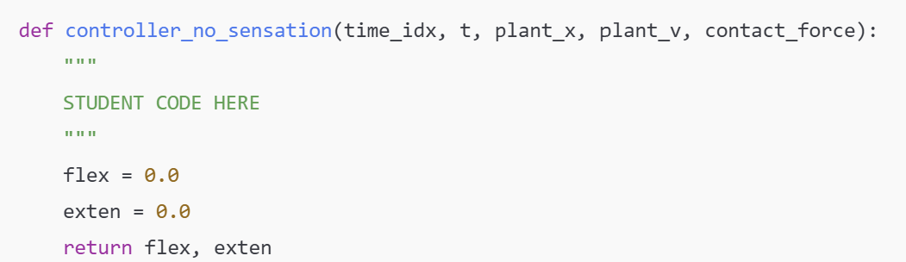
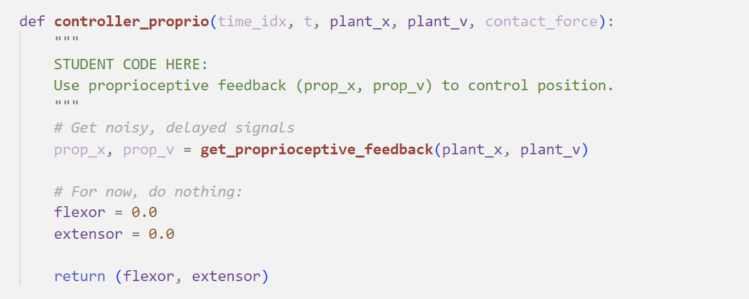
An empty controller
These are the parts you fill in with your own code

